Slide 1
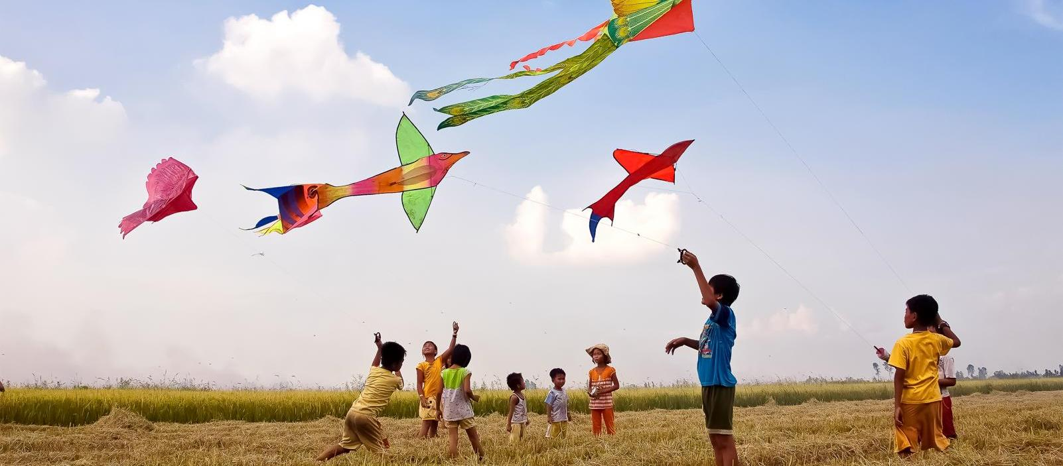
The National Dialog on: “Early Action on Drought and Saline Intrusion in the Southern Provinces of Viet Nam”
Managing dual challenges of COVID-19 and climatic events / natural disasters:
Initial lessons learnt and recommendations
Mizuho Okimoto-Kaewtathip, Chief of Social Policy and Governance, UNICEF Viet Nam
Disaster Risk Management in the Context of COVID-19 Pandemic: Challenges and Solutions
Ha Noi, Viet Nam, 12 August 2020

Slide 2
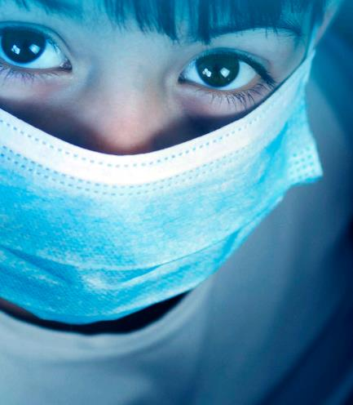
What has changed with COVID-19? The situation of vulnerable people and children in Viet Nam
Reduced access to essential health care services
Limited access to water and weak personal hygiene practices
Uneven access to on-line education especially in the remote areas, ethnic minority children and children with disabilities.
Exposure to violence, mental health issues and isolation
Loss or reduced income and weak social protection systems have left many families at below survival levels while having to spend and borrow more
=> Weaker resilience of families and communities due to new forms of poverty and widening inequality
2
UNICEF for every child

Slide 3
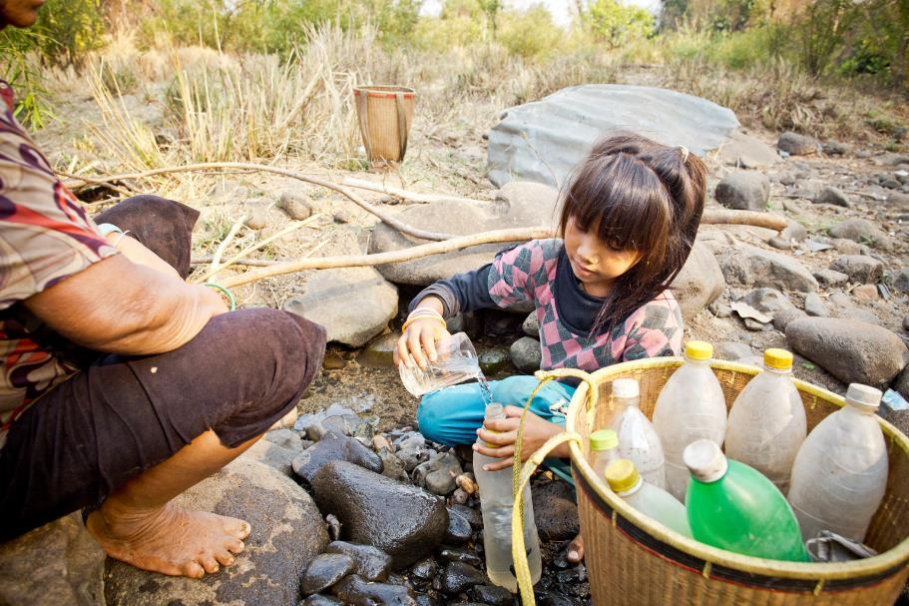
Dual challenges of COVID-19 and natural disasters
Viet Nam could be affected by possible second and third of COVID-19 pandemic and simultaneously by prolonged drought and seasonal natural disasters.
Risks are systemic due to pre-existing poverty and inequalities
Crisis are cascading

Slide 4
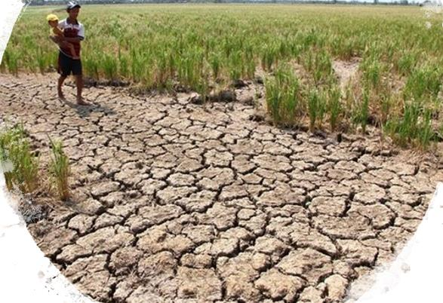
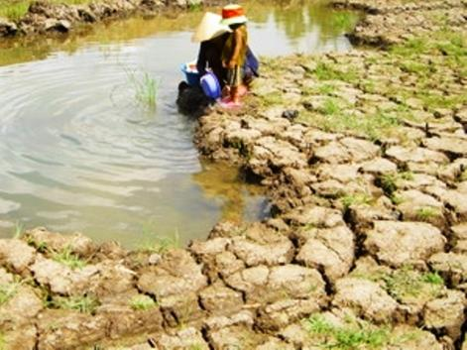
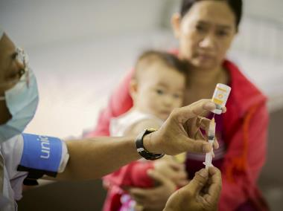
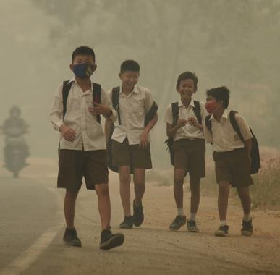
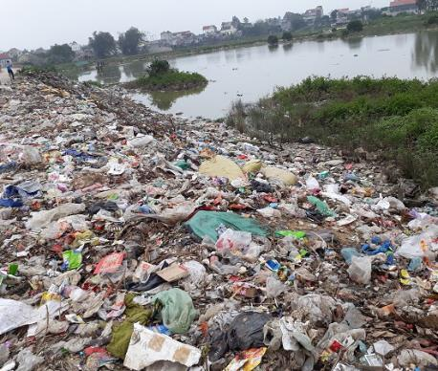
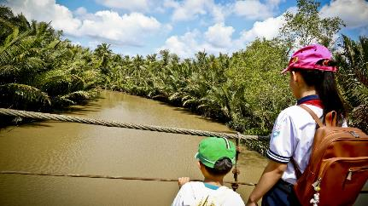
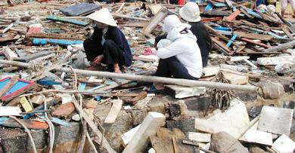
Vulnerability Analysis
Health issues
Access to safe water
Economic issues
Environmental Degradation
Air pollution
Elements → increase vulnerability
Access to quality education
Humanitarian crisis

Slide 5
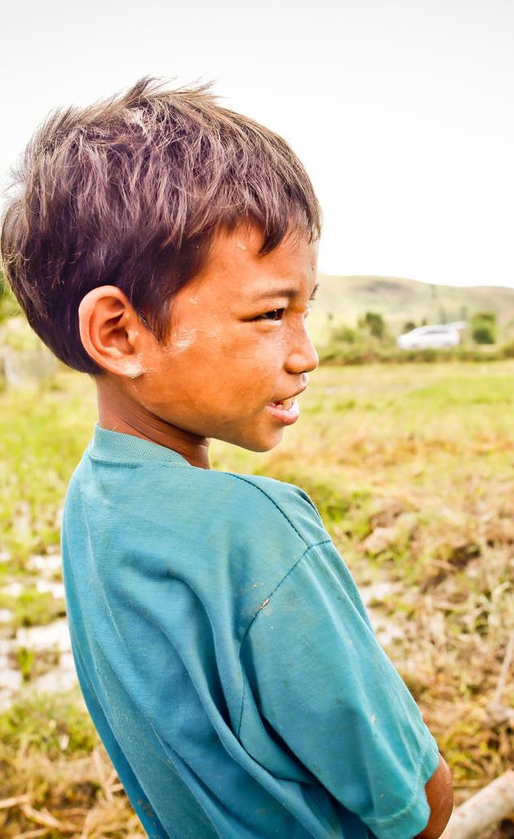
Dual challenges: What are the practical implications?
Dilemma of managing health pandemic while preparing / responding to natural disasters
Public resource could be overstretched
Gaps in knowledge and capacity of official, communities and families on dual challenges
Social distancing requirements could limit on-site response, rapid assessment and monitoring
Shortage of supplies and disruption of value chains could affect timely delivery
UNICEF for every child

Slide 6
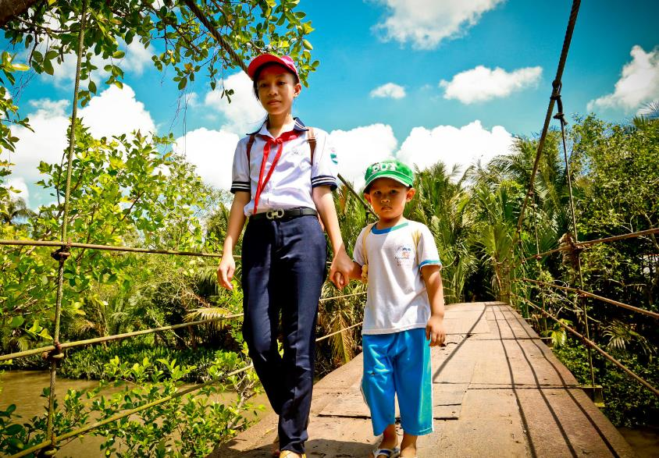
Opportunity to build more resilient, inclusive and sustainable systems: global recommendations
Update multi-sectoral risk analysis
Make DRR, emergency preparedness and response part of GoV’s roadmap and SEDP
Multi-sectoral coordination
Strengthen local capacity and guidance for timely and effective response, following the social distancing protocols
Invest in essential services and incorporate climate risks

Slide 7
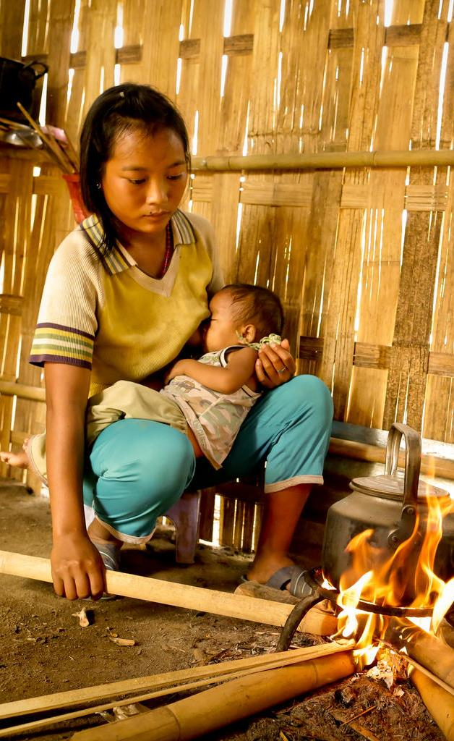
Experience from the Philippines Typhoon Vongfong, May 2020
Government provided
Guidance on minimum health standards and evacuation procedures.
Deployed Barangay Health Emergency Response Team
SOP on internal travel of humanitarian workers.
UNICEF supported
Sectoral response plans and protocols before the typhoon
Virtual assessments to collect data on children
Lessons learnt
Revisit the Mass Evacuation Plan
Preposition critical supplies including health minimum standard protocols in evacuation sites.
Provide technical support to local government to develop the minimum preparedness actions including contingency plans and sectoral preparedness
Ensure robust pre-disaster baseline data.
UNICEF for every child

Slide 8
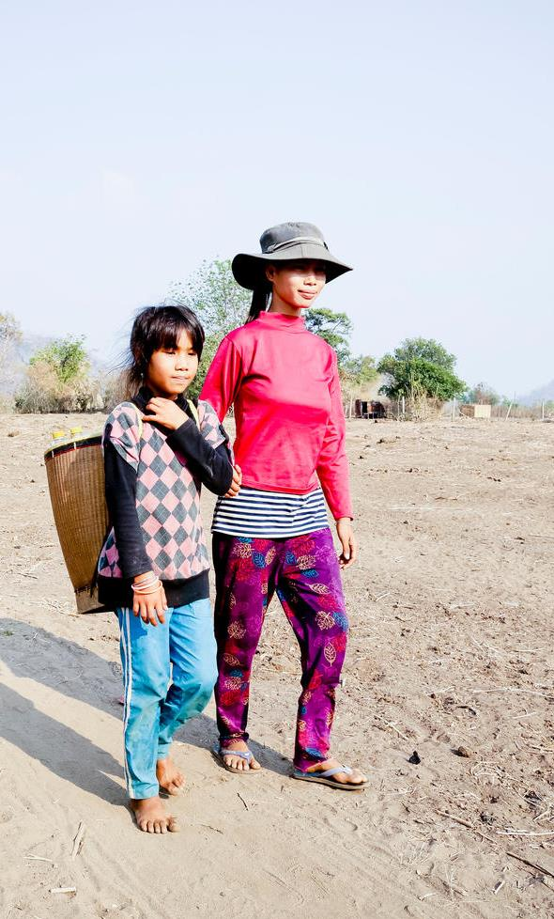
Experience from the Pacific Tropical Cyclone Harold, April 2020
UNICEF prepositioned supplies in partnership with First Action Initiative to stockpile supplies in Brisbane Warehouse. EU, US, Fiji and mercy flight of Australia supported transport of supplies.
Worked with governments for exemption on travel restrictions and new protocols to transport supplies.
Lessons learnt
Include pandemic-like scenarios in risk analysis.
Maintain pre-positioned supplies both in-country and through regional/sub-regional hubs.
Establish long-term agreements on freights forwarders.
Mobilize partnerships key donors and the private sectors.

